Slide 1
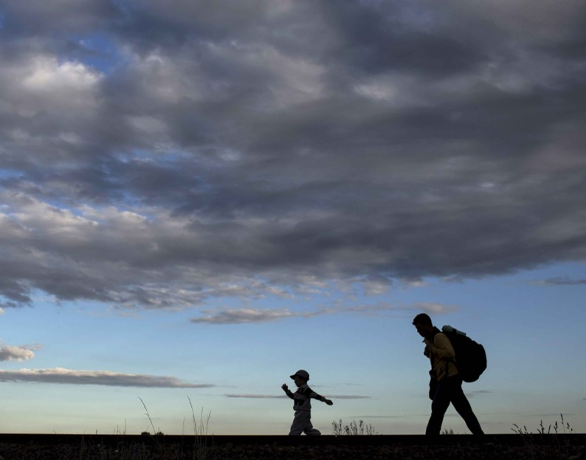

Share the JOURNEY
Stations of the Cross

Slide 2
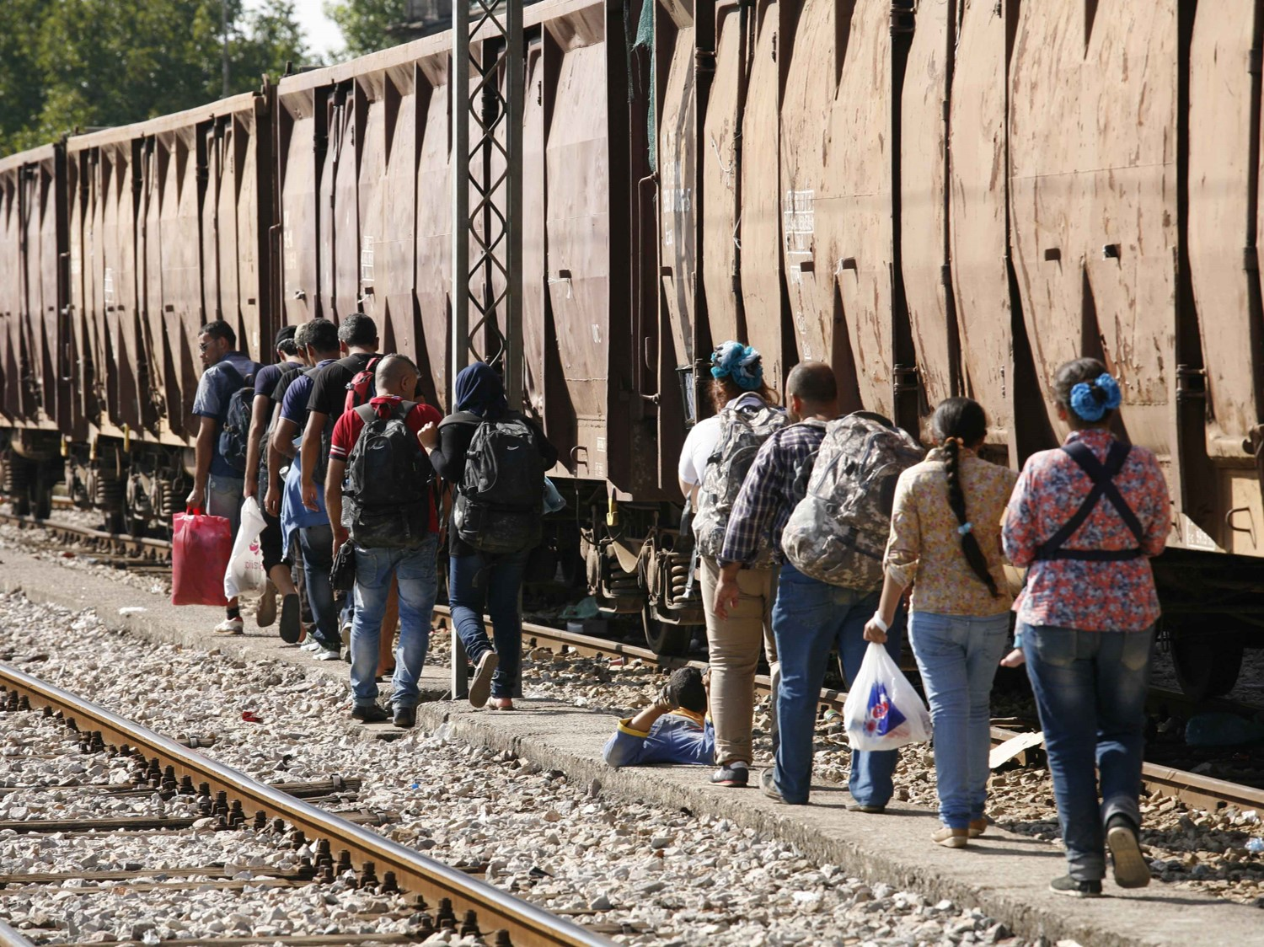
1. Jesus is condemned to death

Slide 3
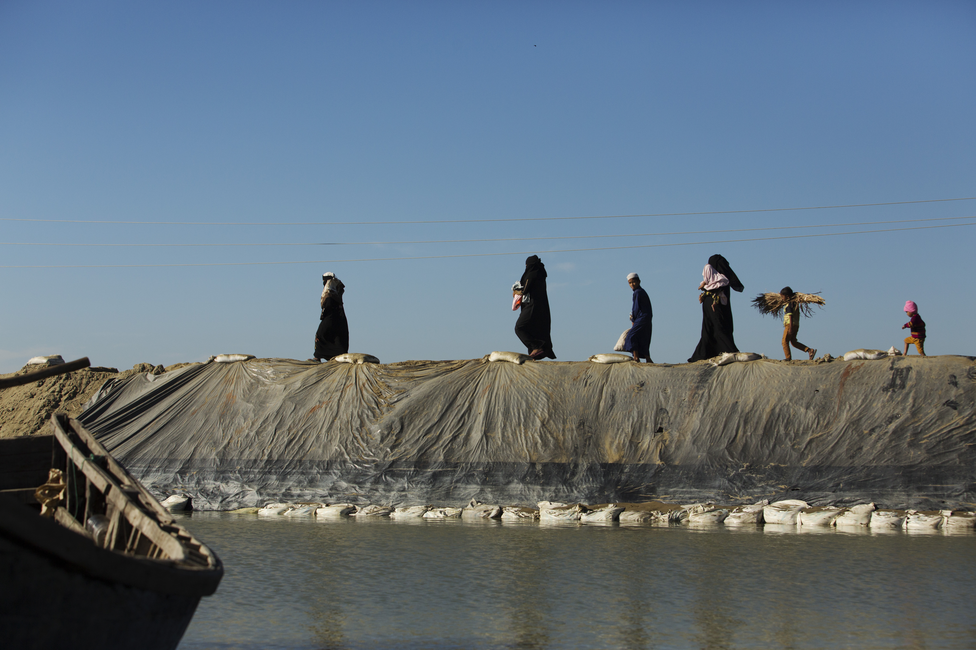
2. Jesus accepts his cross

Slide 4
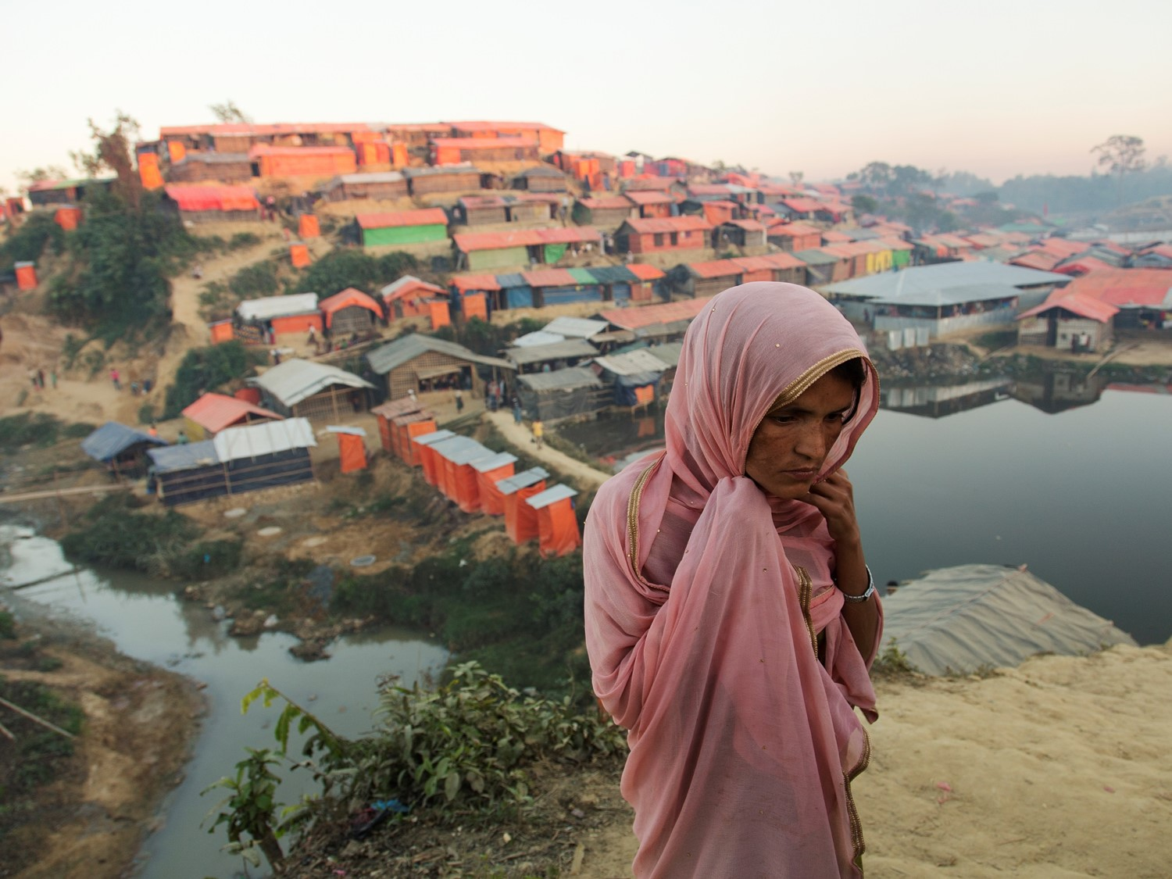
3. Jesus falls the first time

Slide 5
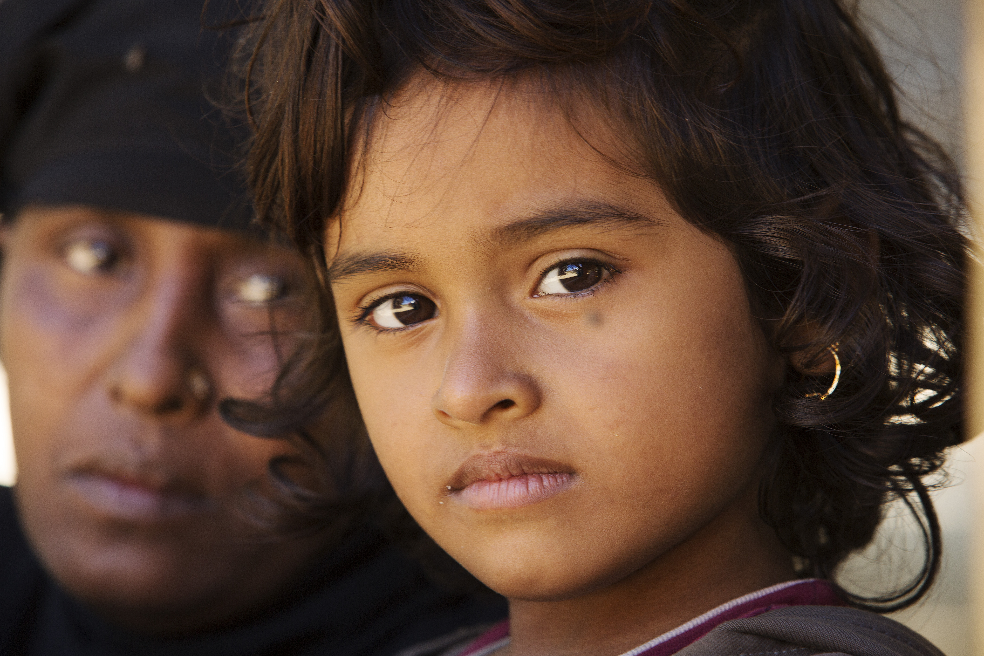
4. Jesus meets his mother

Slide 6
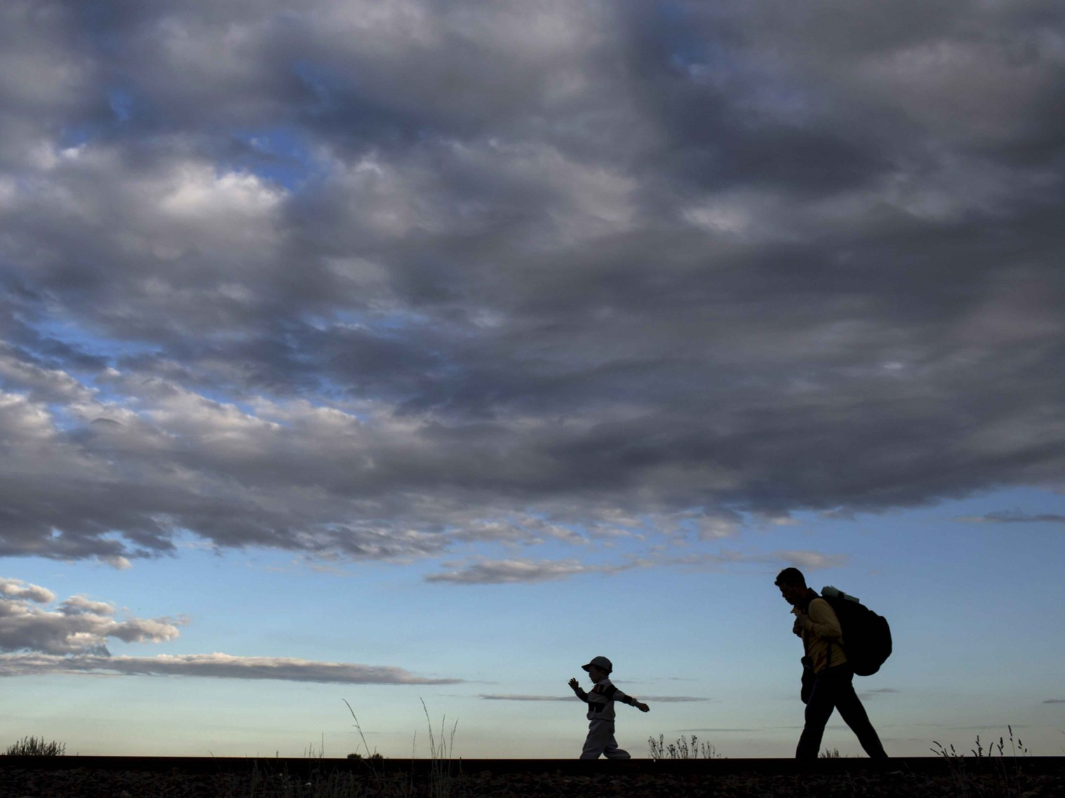
5. Simon of Cyrene helps Jesus

Slide 7
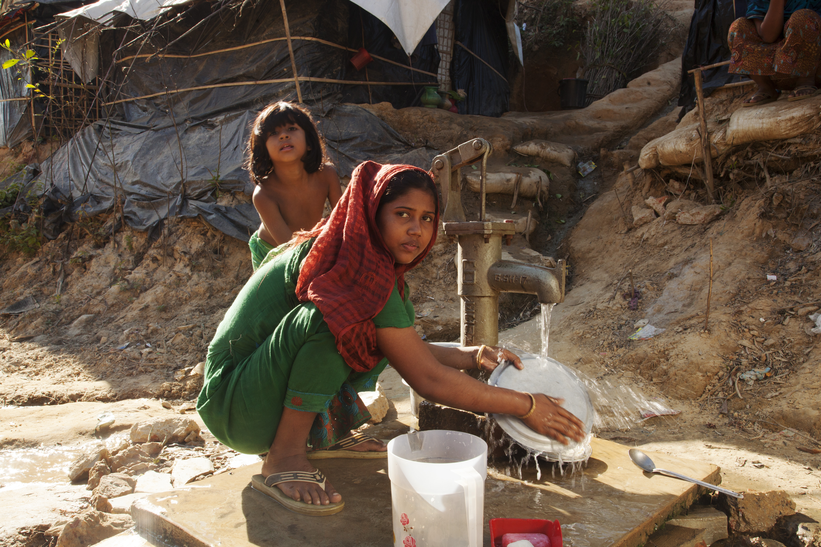
6. Veronica wipes the face of Jesus

Slide 8
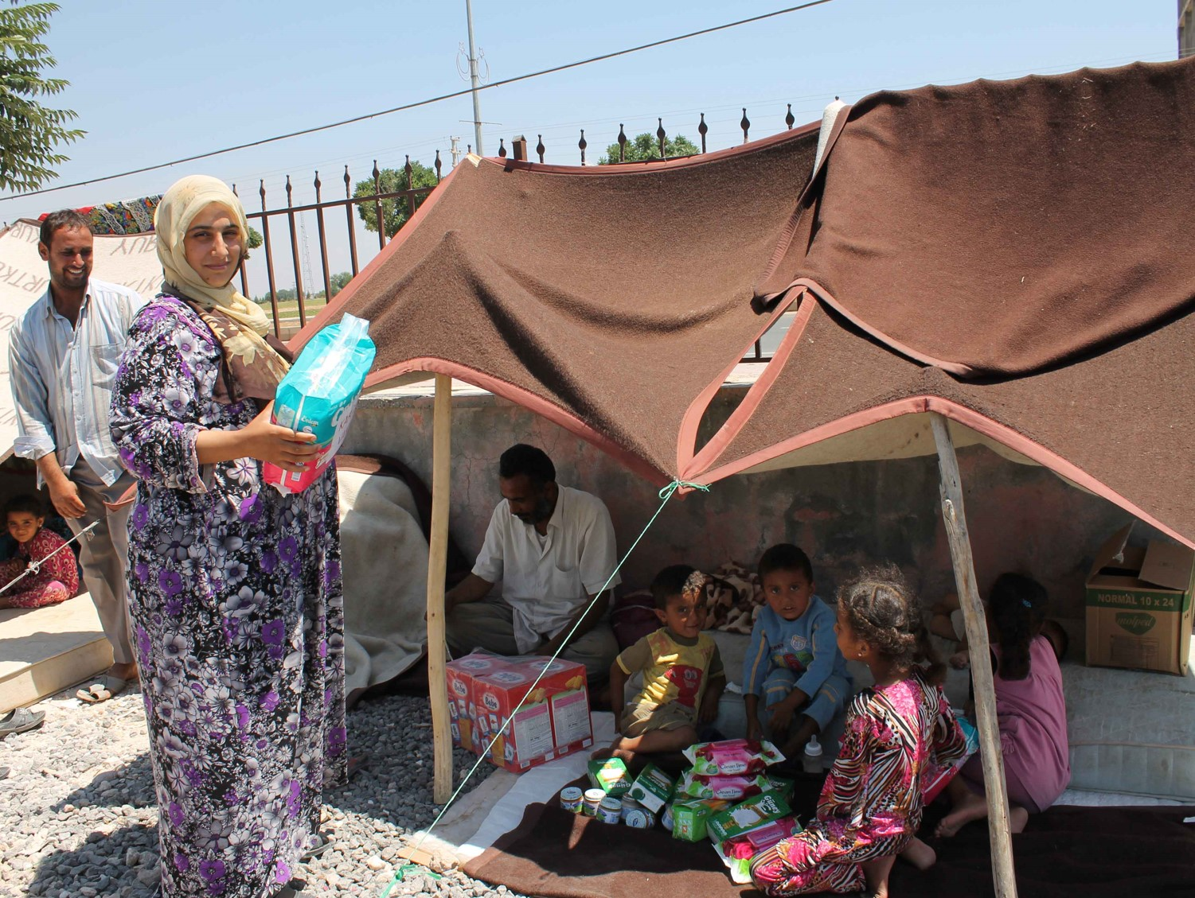
7. Jesus falls the second time

Slide 9
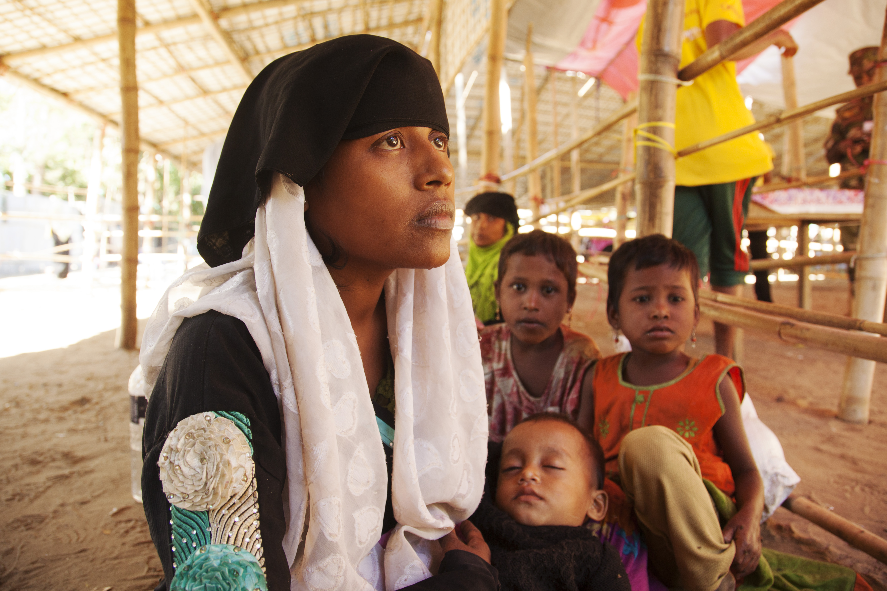
8. Jesus meets the women of Jerusalem

Slide 10
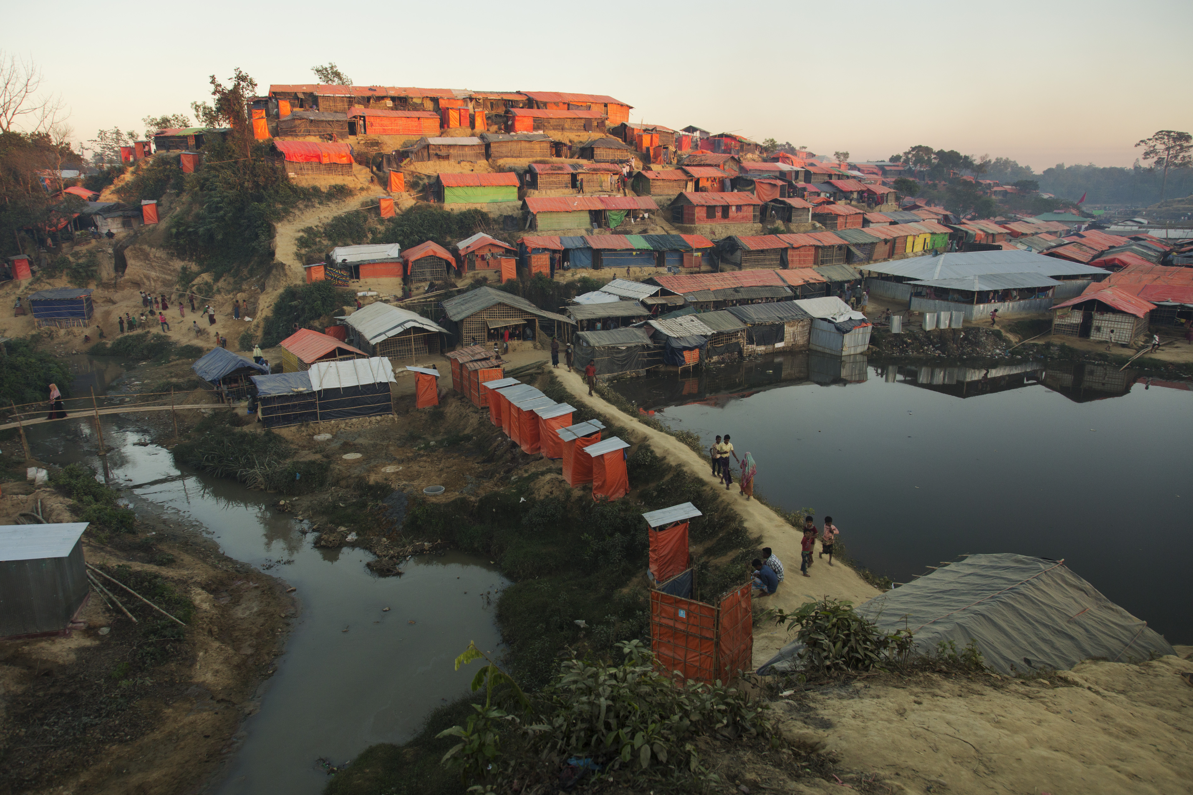
9. Jesus falls the third time

Slide 11
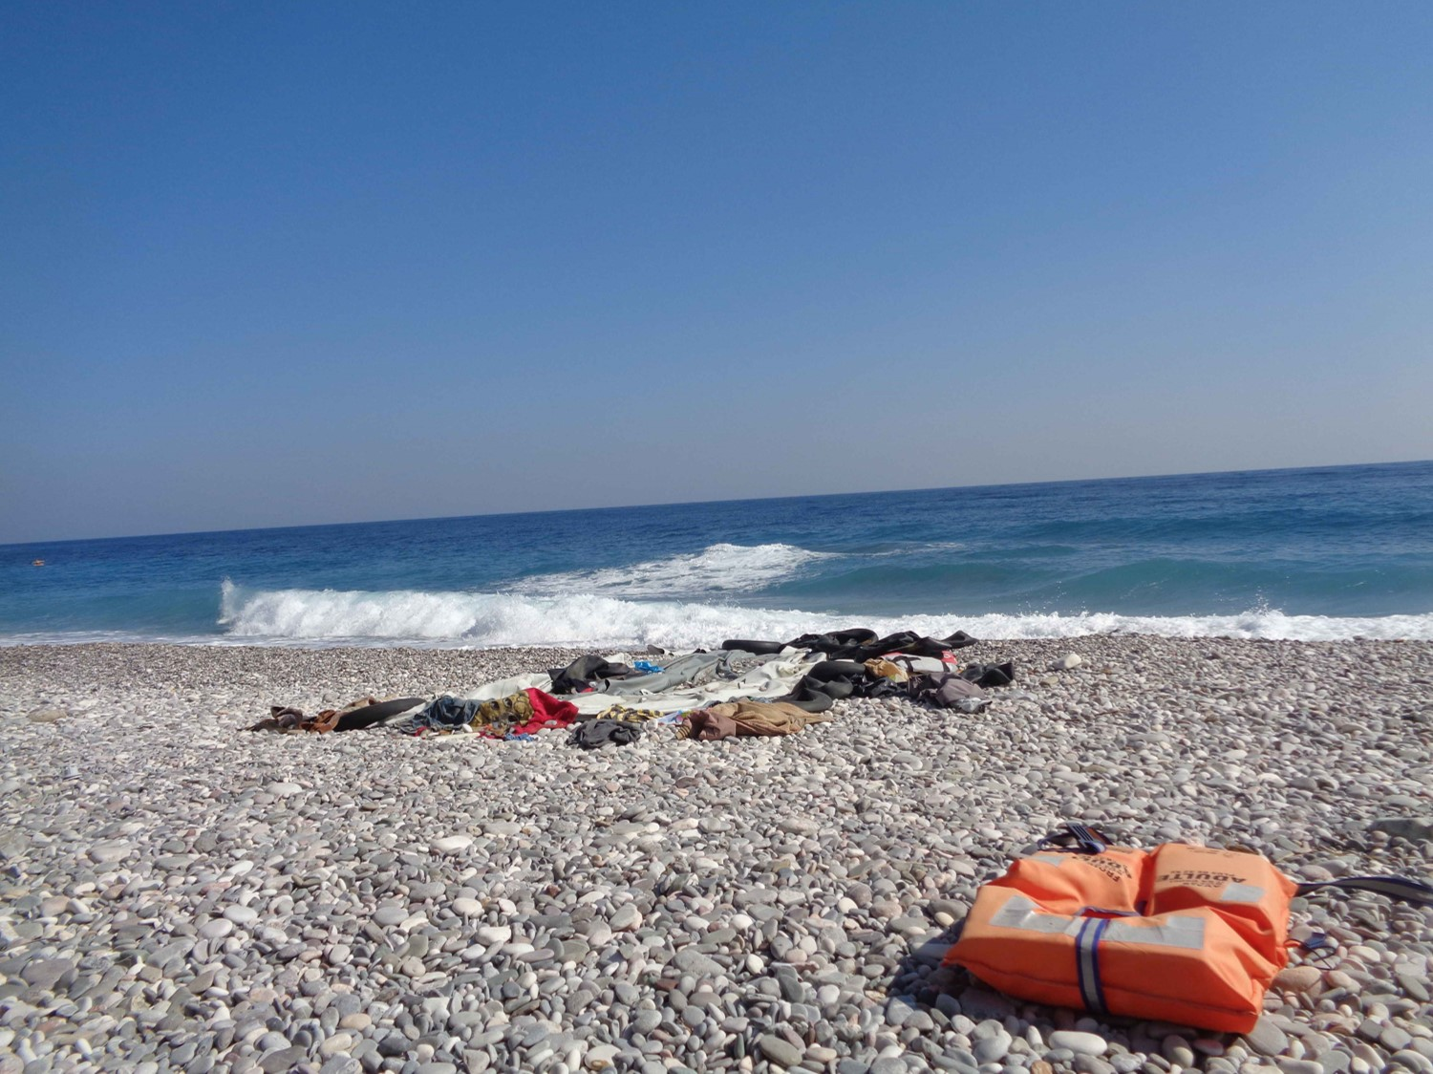
10. Jesus is stripped of his clothing

Slide 12
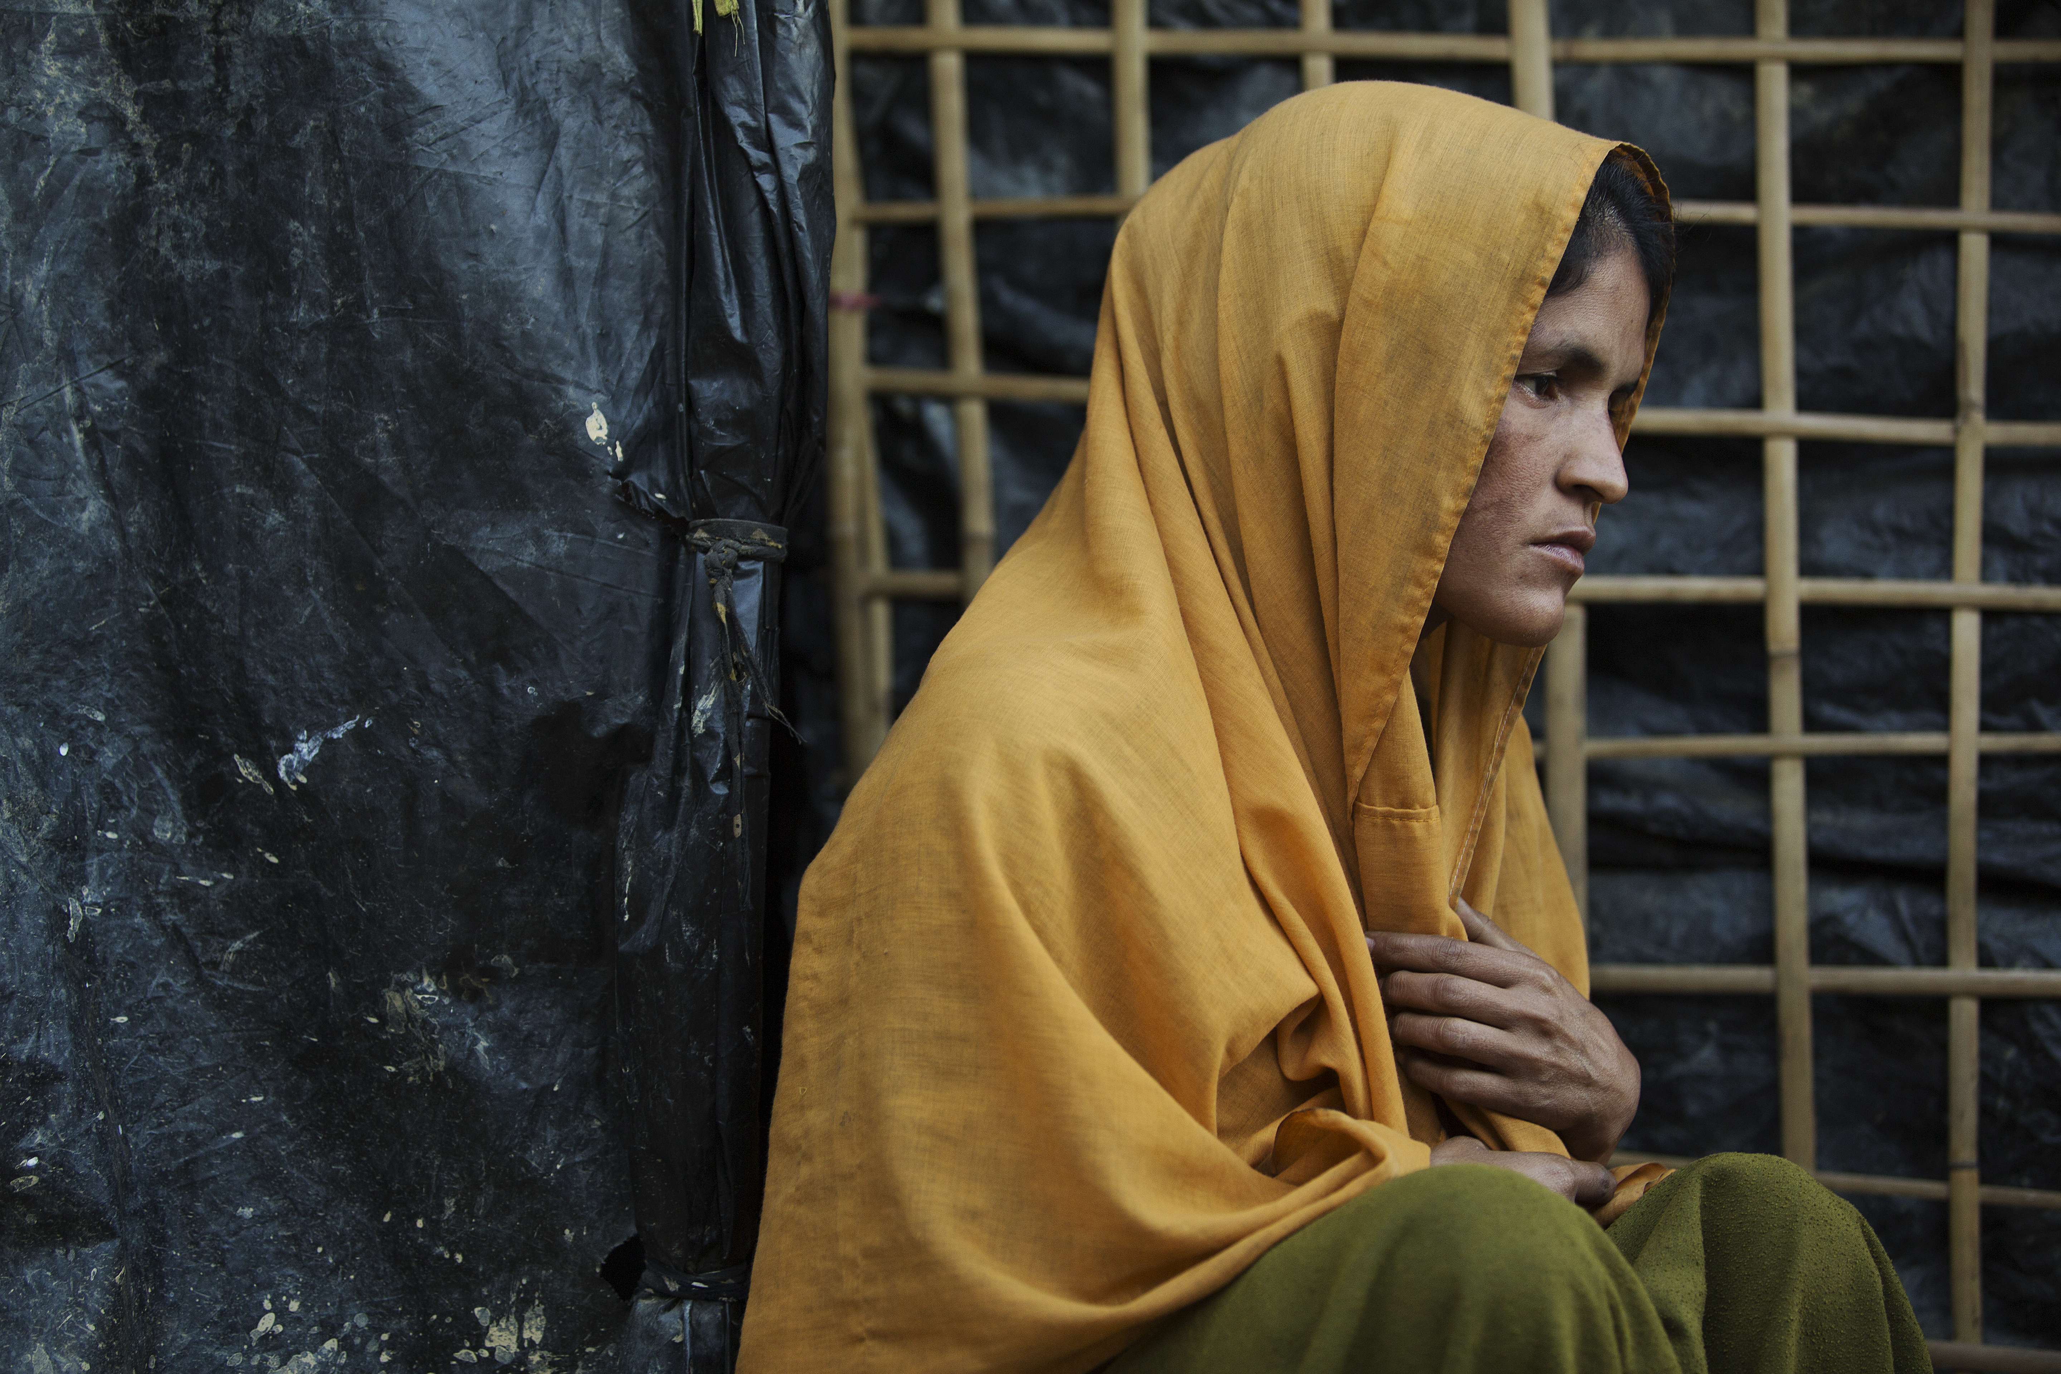
11. Jesus is crucified

Slide 13
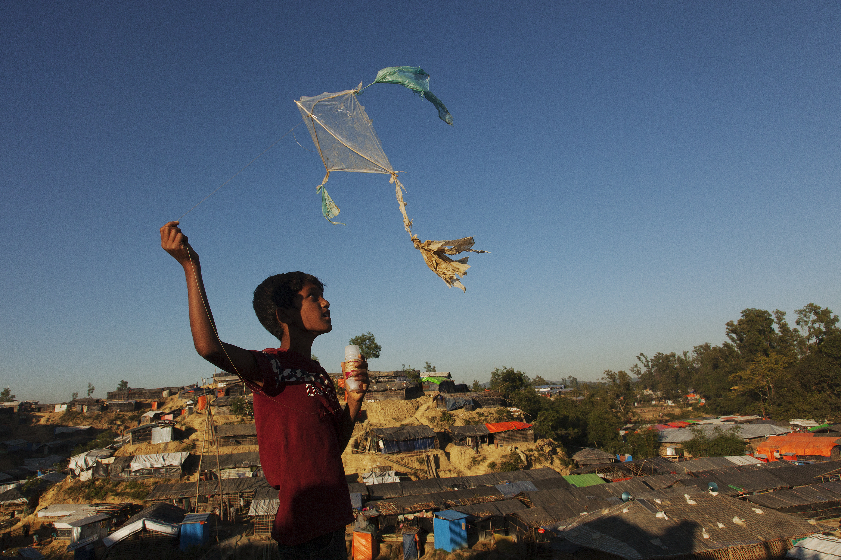
12. Jesus dies on the cross

Slide 14
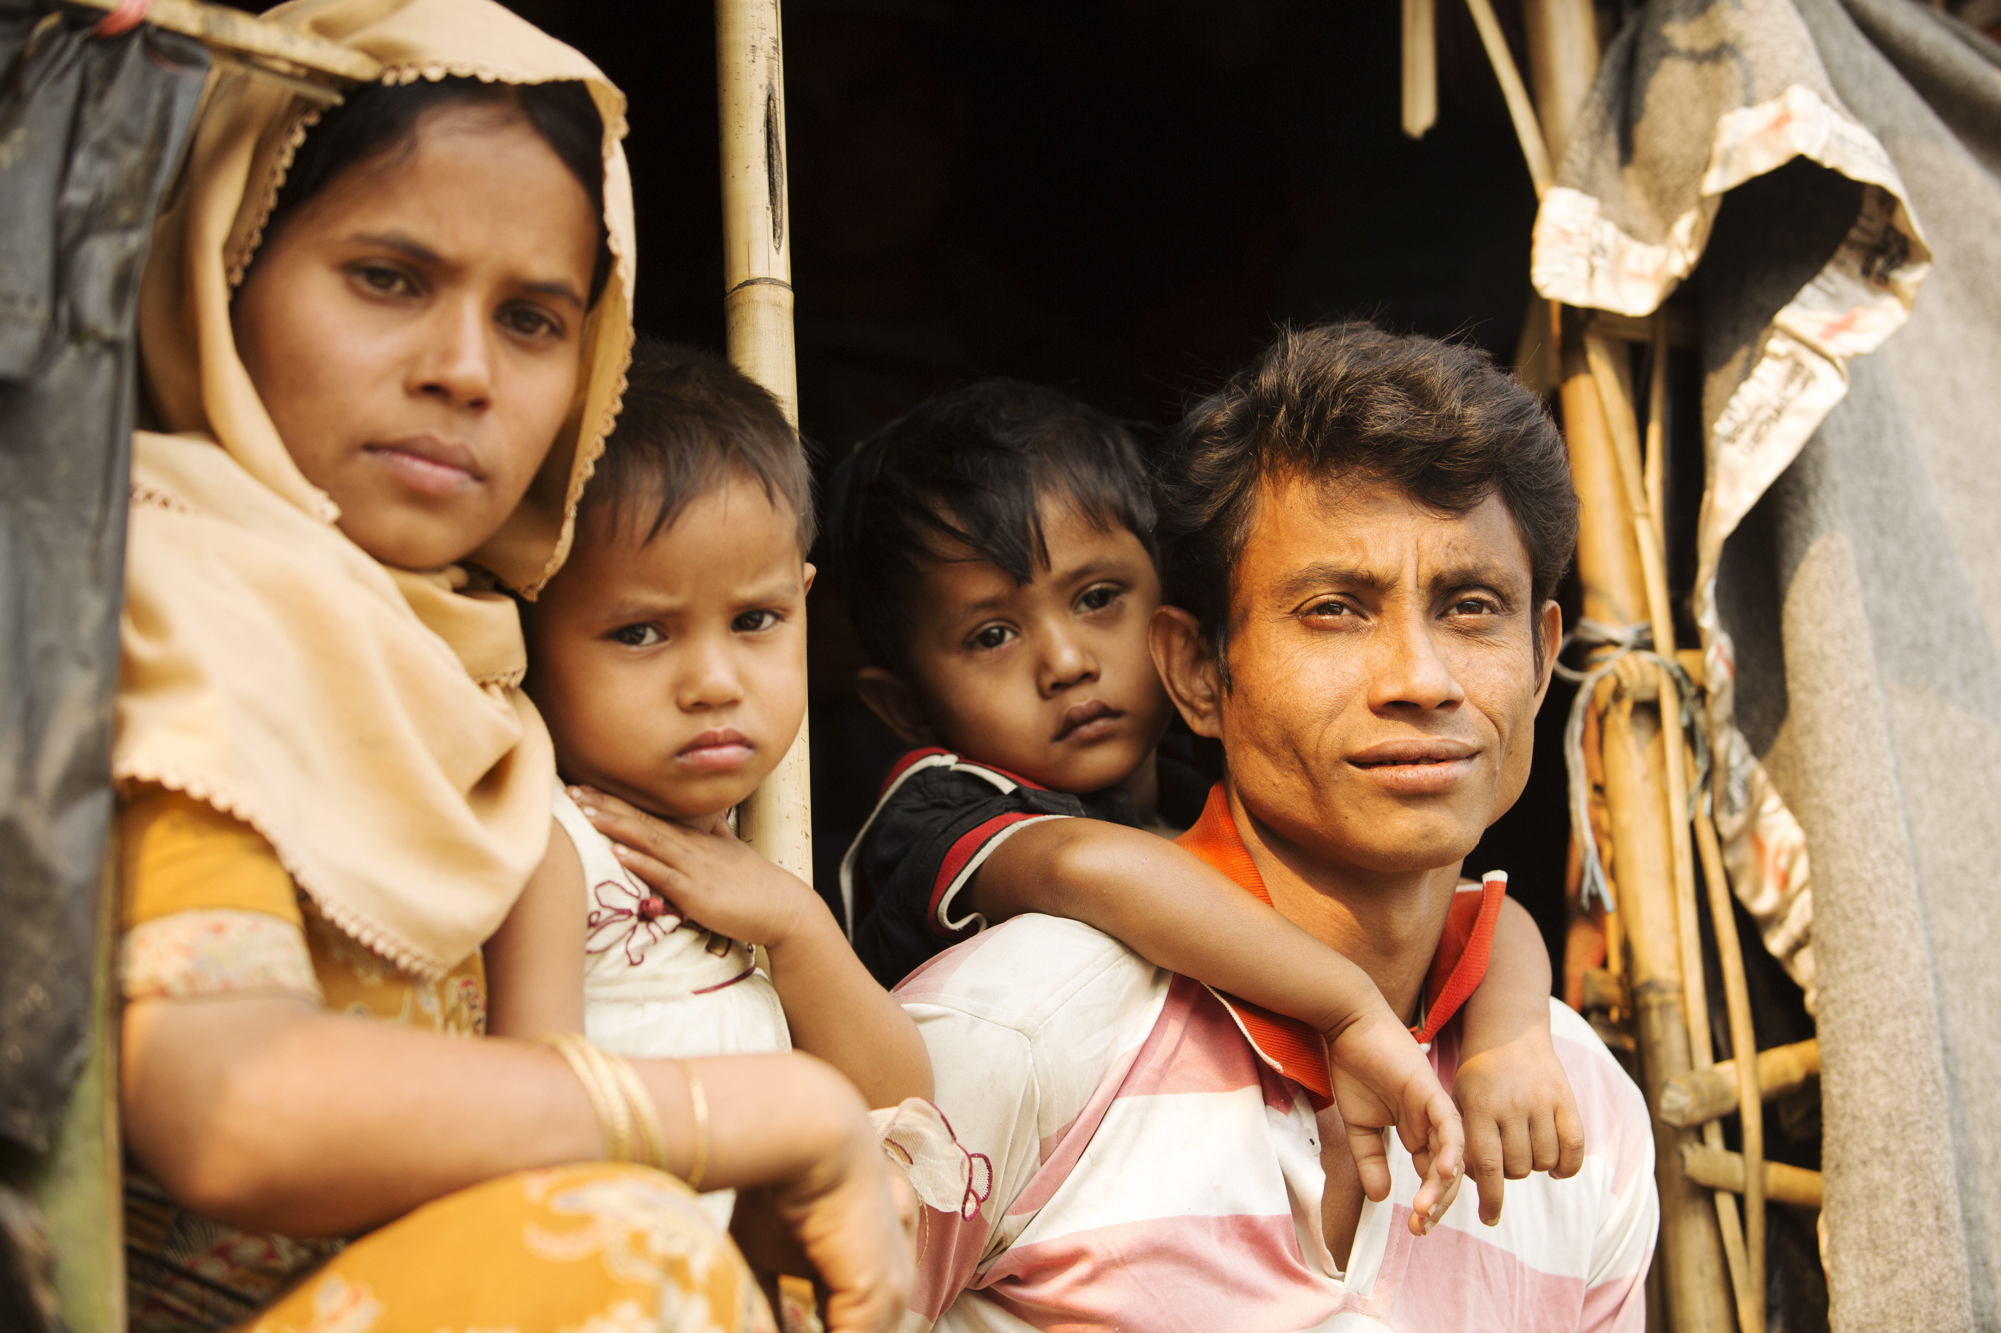
13. Jesus is taken down from the cross and placed in the arms of his mother

Slide 15
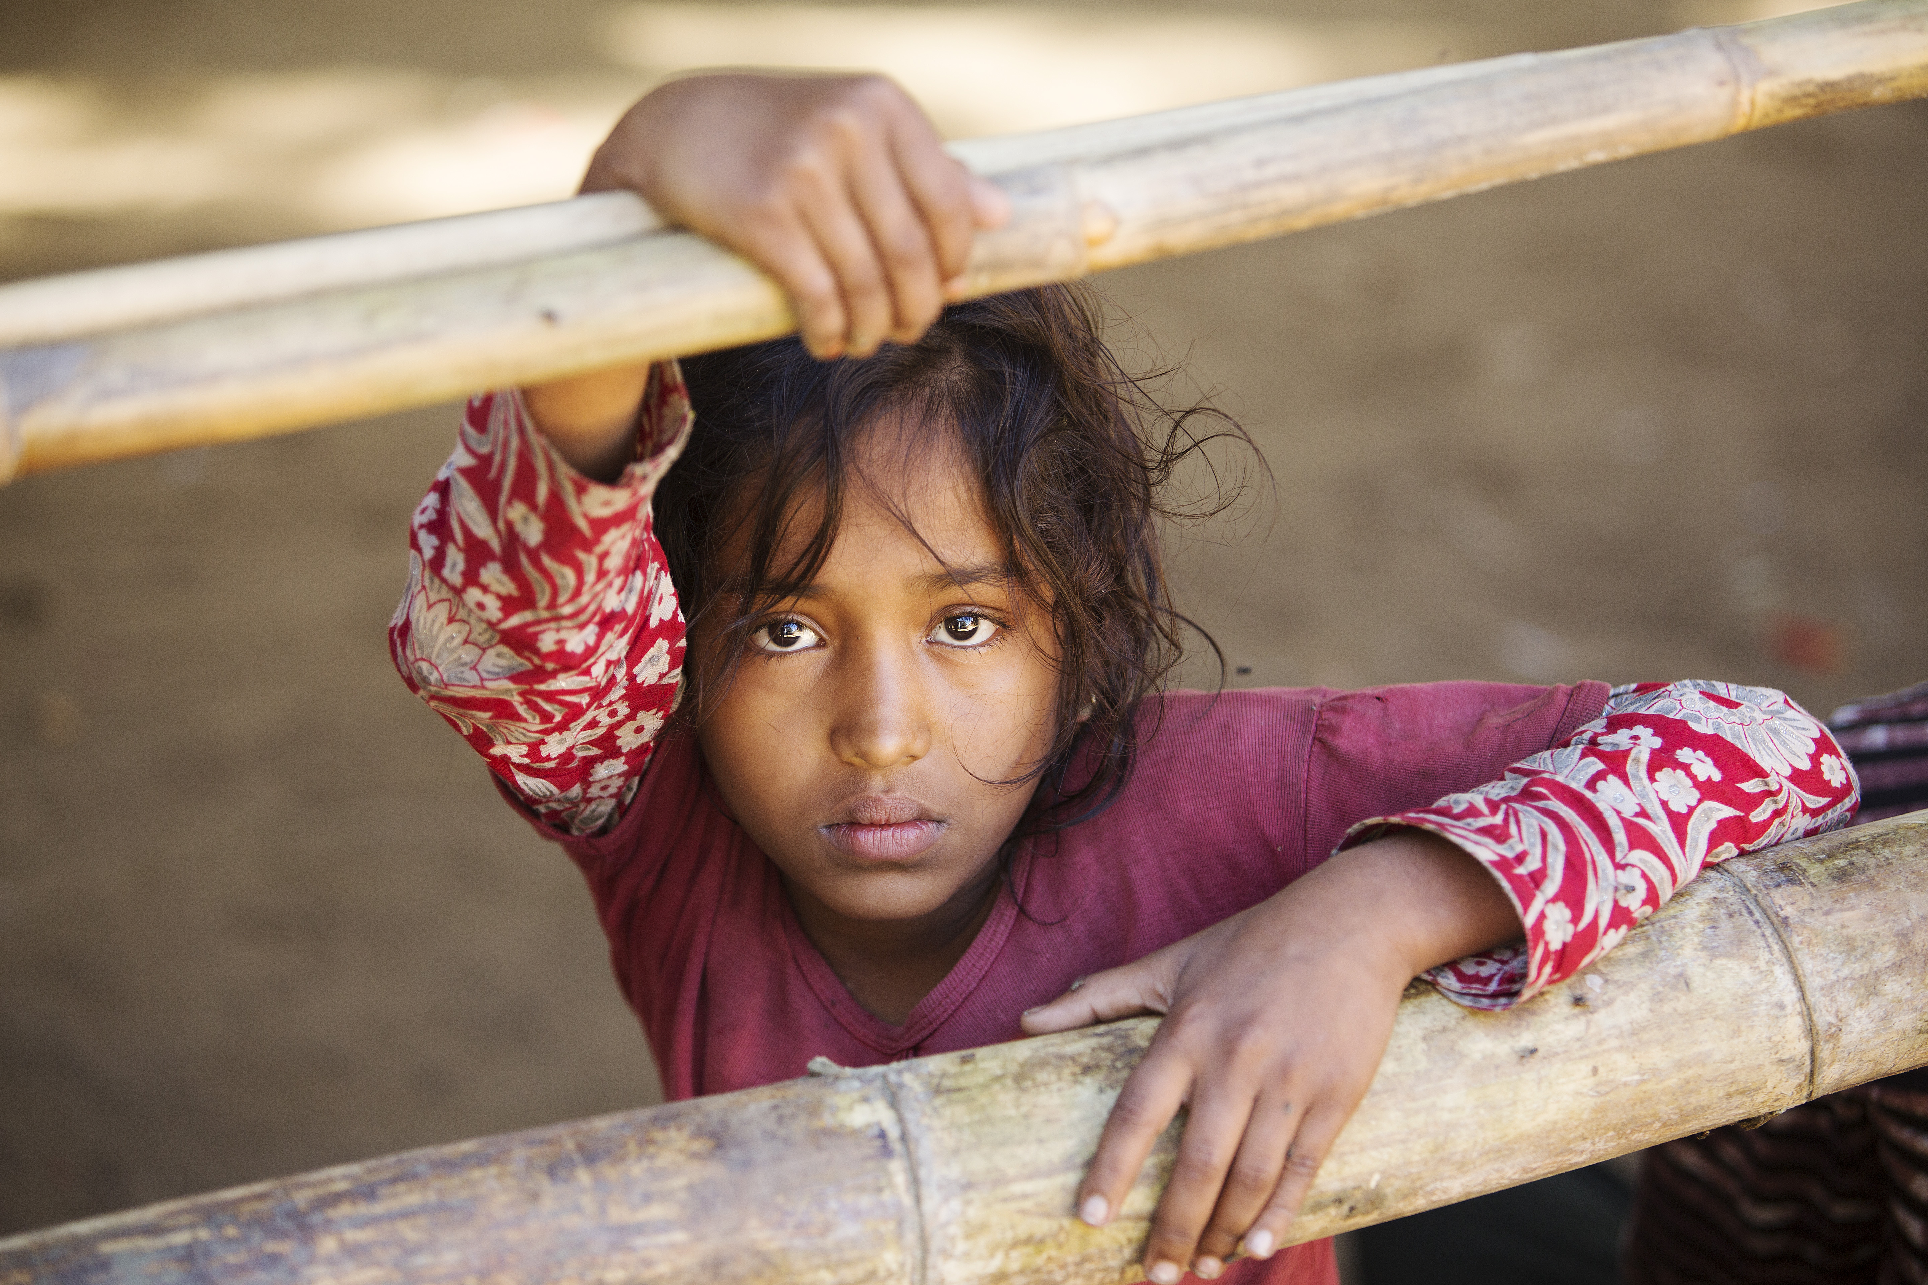
14. Jesus is laid in the tomb

